Slide 1


Project Presentation
CS5520
Summer 2 2023
Group 5: Yang Li, Youjing Shen
Apple Store
Google Play

Slide 2
VanLandlordReviews
Introduction

Slide 3

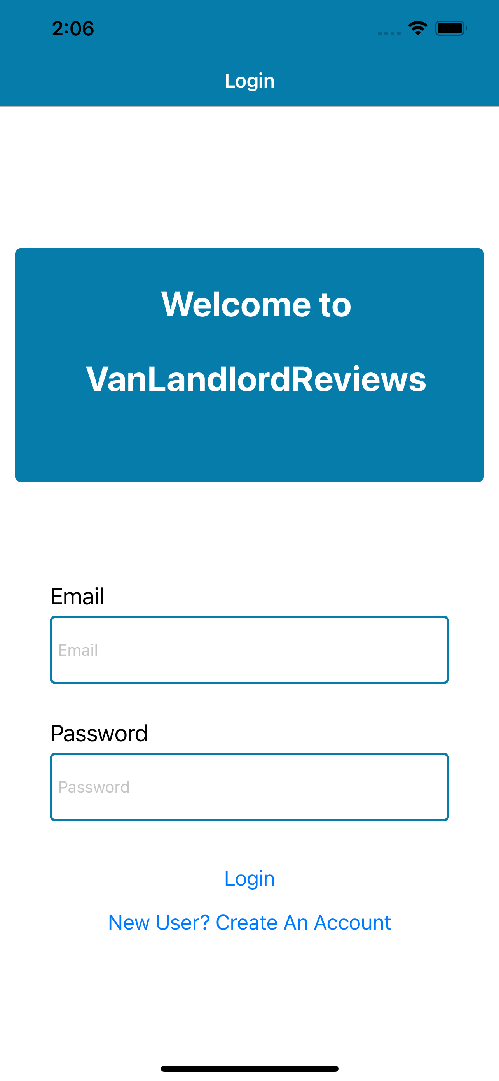
VanLandlordReviews
Know Your Landlord Before You Move In!
Problem
With the ever-increasing housing market in Vancouver, it’s crucial to make informed decisions on where you’ll be staying next.
Solution
1. Provides a to share experience
2. Offers a mobile-first experience with on-the-go access
3. Tailored for Vancouver
4. Integrated features
Enable Users
To make informed decisions with convenience, transparency and credibility.

Slide 4
Important features of app VanLandlordReviews
Link: https://youtu.be/wihyv3EsQr4
Demo

Slide 5
Here comes the ... app!

Slide 6
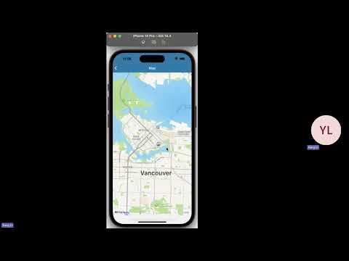

Slide 7
Technology Stack
and APIs

Slide 8

Technology Stack
Frontend: React, React Native
Database and backend: Firebase
API: Walk Score https://www.walkscore.com/professional/api.php

Slide 9
Data Model

Slide 10





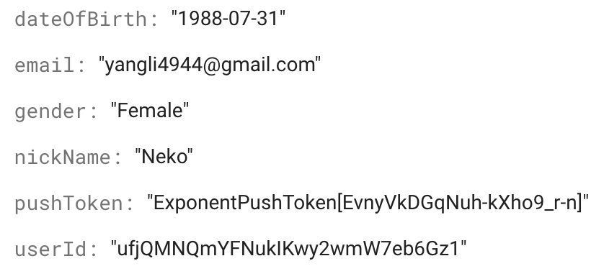
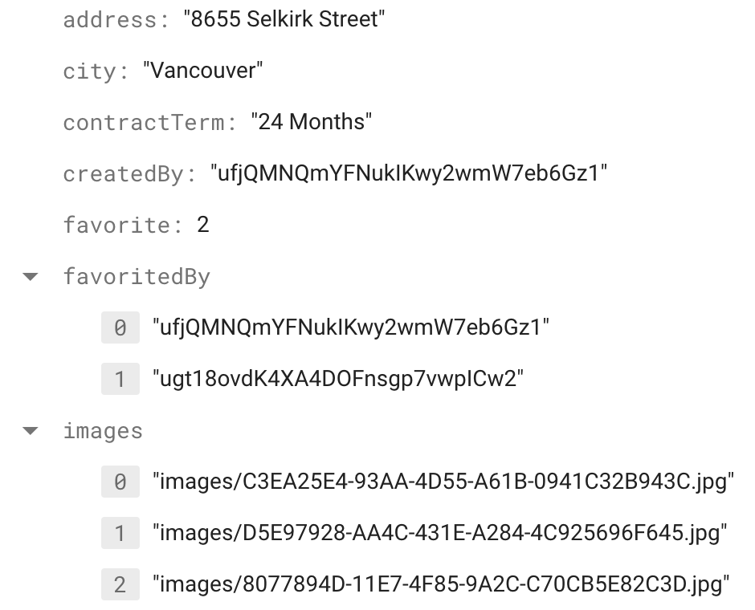


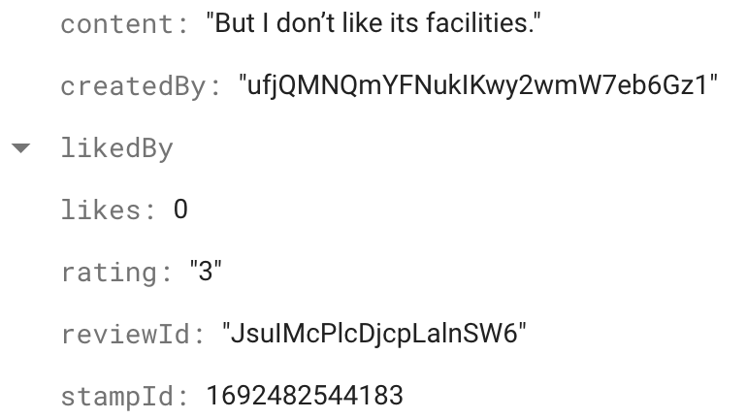
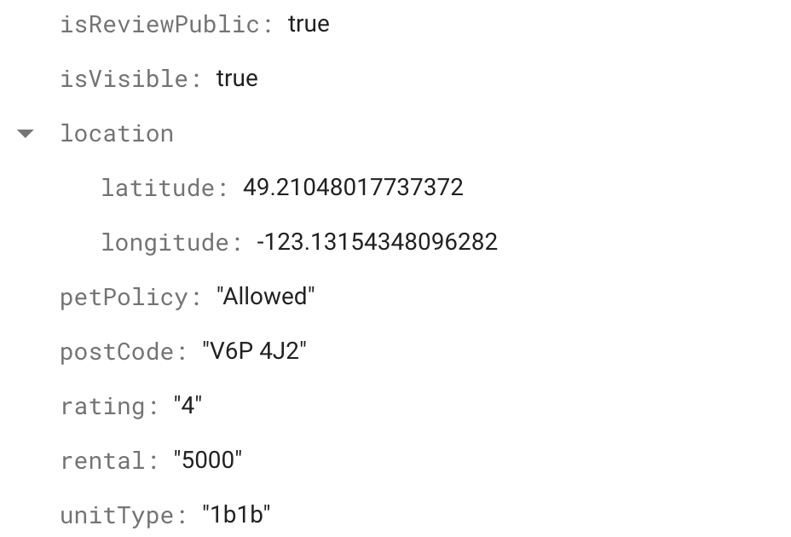
Collections:
users
reviews
comments

Slide 11
Reflection and
Future Research

Slide 12

Characteristics
Effiecient
Rich functionality
(Time-consuming challenge)
UX friendly
1. Easy Onboarding
2. Intuitive Navigation
3. Minimalistic Design
4. Adaptive and Responsive Design

Slide 13

Future Development
Search function
To enable users to select an address to see their associated details and reviews.
Accessibility
To make the app usable by everyone, including those with disabilities, this includes providing voice alternatives for texts, making sure the app can be navigated with a keyboard.
Regular Updates
User needs and technology landscapes change. Regular updates ensure that the app remains compatible with the latest devices and meets the current needs of its users.

Slide 14
Thank You!

